Slide 1
E-marketing app
Empowering SMEs

Slide 2
The purpose of the app
The aim of this app is targeted at local small and medium business owners who are looking to develop or improve their marketing strategy online. The purpose is to determine how much impact online marketing can have on their businesses and the best application(s) besides social media, to use to reach the most customers.
The Benefits are as follows:
Unlike traditional marketing, this will give them the ability to monitor the performance of their businesses in real-time.
Gaining additional customers will be essential for growing their business in terms of revenue and profitability.
It will allow for much more specific audience targeting.
A well-designed app will work for them every hour of the day, allowing potential customers to easily browse their services and products outside of working hours.

Slide 3
The roles involved:
The Product Owner
Scrum Master
Development Team
5 Developers
3 Testers
2 Business Analysts

Slide 4
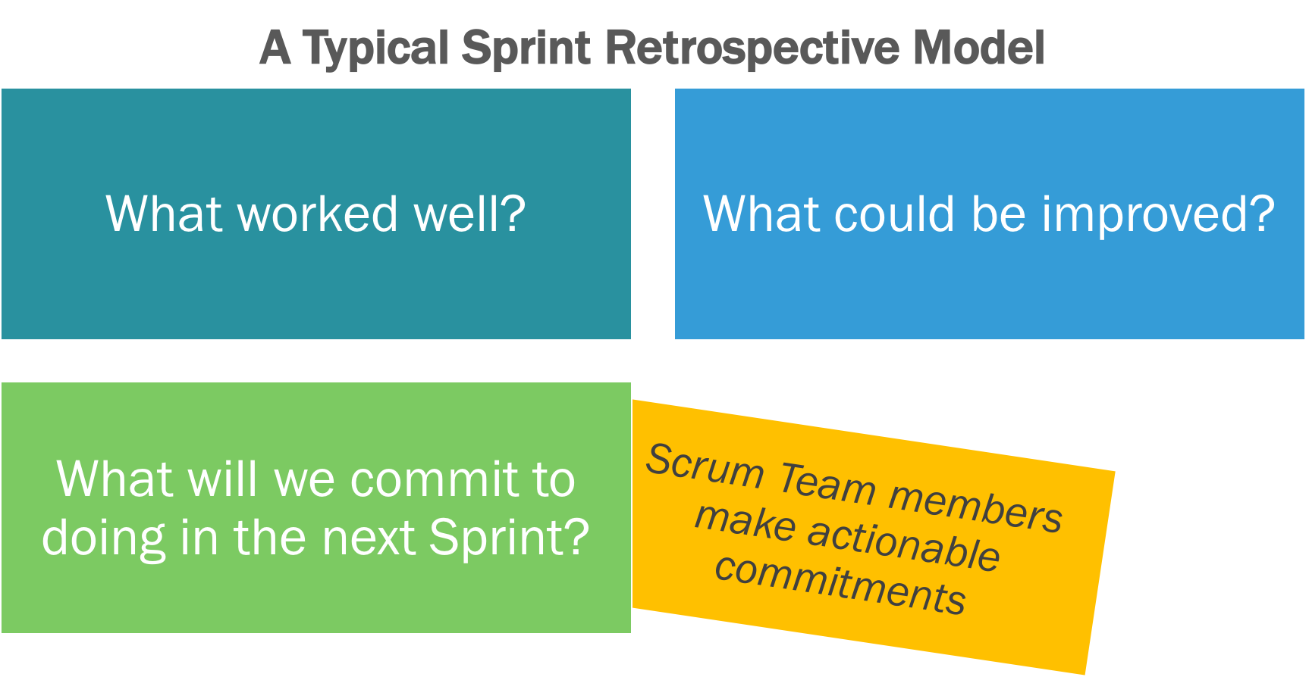
The Events involved:
Sprint
Sprint Planning
Daily Scrum
Sprint Review
Sprint Retrospective

Slide 5
The artifacts:
What is an artifact?
3 Scrum Artifacts
Product Backlog
Sprint Backlog
Potentially Releasable Increment Product

Slide 6
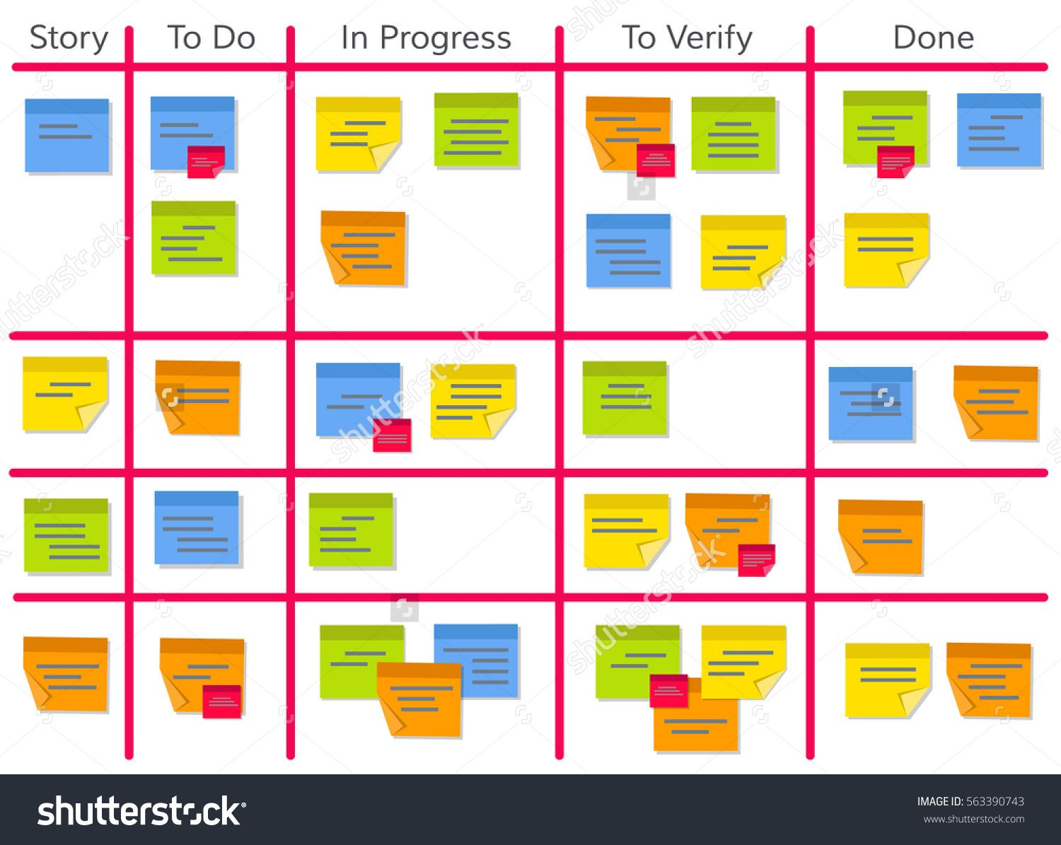
Product backlog & sprint backlog Examples:
#ID | As a/an | I want to … | So that …
1 | user | create an account | I can be able to access the platform.
2 | user | be able to post / advertise my goods and services | I can reach customers in different places.

Slide 7


